Slide 1

Early Stage Heart Disease Prediction using Machine Learning Technique
Student Member:
ILIYAS ANSARI
Reg. No:- 22MCA1079
Guide:
Dr. D. Kavitha
Assistant Professor
Senior Grade II
1

Slide 2
Abstract
Heart disease is one of the leading cause of deaths worldwide. Predicting and detecting heart disease has always been a difficult and time-consuming task for doctors.
Machine learning has shown strong effectiveness in decision-making and predictions. Building machine learning models to predict heart disease at early stage will benefit the people around the world, allowing them to take required treatment before it becomes serious.
The prediction model is proposed with combinations of different features and several classification techniques like K Nearest Neighbours Classifier, Support Vector Classifier, and Random Forest Classifier.
Cardiovascular disease is predicted by using a greater number of input attributes. The system uses medical terms such as Sex, Age, Blood Pressure, Cholesterol attributes to predict the likelihood of patient getting a Heart disease.

Slide 3
Introduction
When modern technology and specialists are unavailable, diagnosing and treating cardiac conditions is extremely challenging. A cardiac issue is frequently recognized by symptoms such as a high BP, discomfort, hypertension, asystole, and so on. Chest ache, difficulty in breath, and discomfort are the most prevalent signs.
There are mainly two types of risk factors which are responsible for heart diseases. One category of factors is including those factors which cannot be controlled such as family history, human age and gender. Another category includes those factors which are responsible for heart diseases and can be controlled. Risk factors such as smoking habits can be controlled.
Various machine learning-based diagnostics strategies are offered in the research by scientists to diagnose HD. Many studies have been conducted in relation to disease prediction systems using various machine learning algorithms.
3

Slide 4
Motivation
Heart disease affects the functioning of the heart. WHO had made a survey that in year 2016, 17.9 million people lost their lives due to heart disease. India accounts for one-fifth of these deaths worldwide especially in younger population.
The deaths due to Cardiovascular disease have reduced in several developed countries, whereas the same has increased in low and middle income countries like India. Death rate associated with CVD in Indians is 20-50% higher than any other population.
The heart diseases can be detected by many ways and angiography is the most common way to detect heart diseases.
However, the angiography method has several disadvantages. This is an expensive operation, and doctors must consider many factors when diagnosing patients, which makes the doctor's job extremely difficult.
These shortcomings encourage researchers to develop a noninvasive method for predicting heart disease. So, there is a need to develop an automated system that can detect heart diseases on the basis of various human medical factors.
4

Slide 5
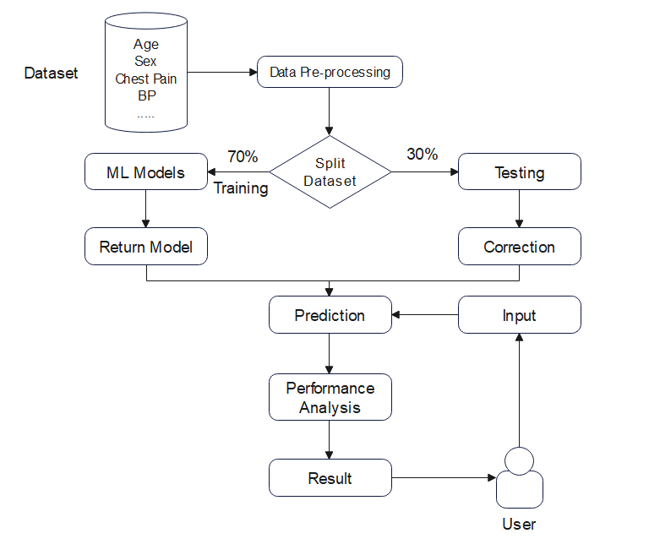
Flow Chart of Proposed Model

Slide 6
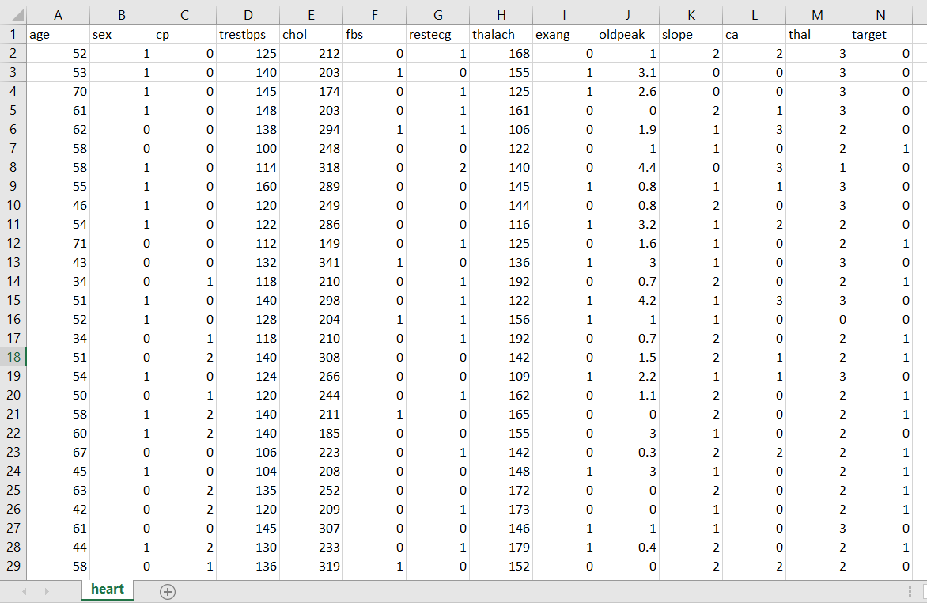
Sample Data Set
age in years
(1 = male; 0 = female)
chest pain type(4 values)
resting blood pressure
serum cholestoral in mg/dl
(fasting blood sugar &gt; 120 mg/dl) (1 = true; 0 = false)
resting electrocardiographic results
maximum heart rate achieved
exercise induced angina (1 = yes; 0 = no)
ST depression induced by exercise relative to rest
the slope of the peak exercise ST segment
number of major vessels (0-3) colored by flourosopy
1 = normal; 2 = fixed defect; 3 = reversable defect
1 or 0 (0 = no disease and 1 = disease)

Slide 7
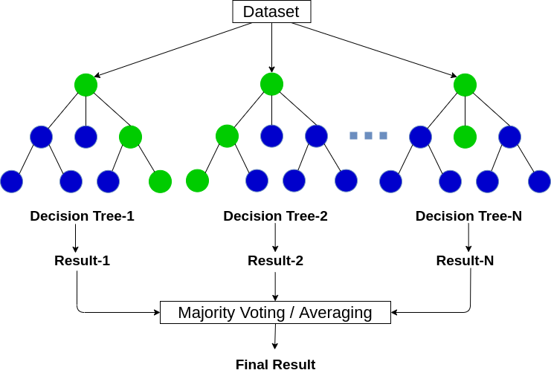
Random Forest
A Random Forest contains multiple decision trees for subset of the dataset, and calculate average to improve the accuracy of the model.
More number of trees gives the highest accuracy of the algorithm.

Slide 8
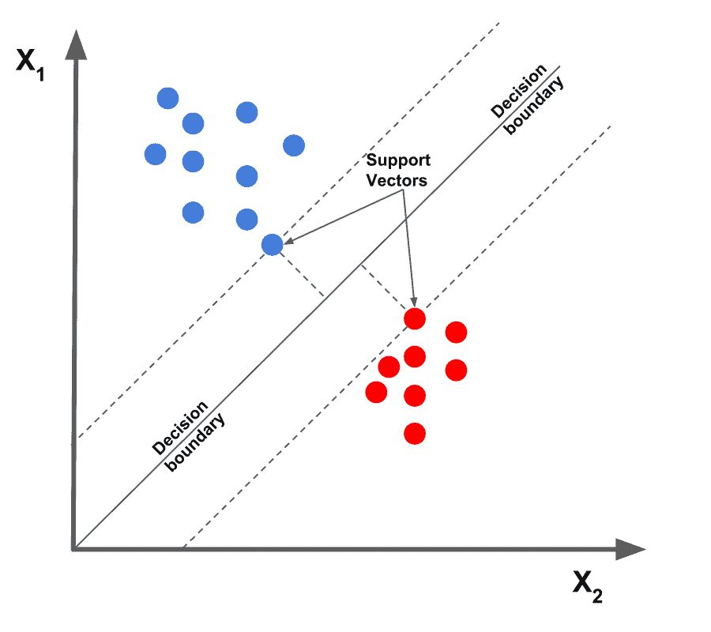
Support Vector Machine
The SVM algorithm creates a line or a hyperplane which separates the data into classes.
Since we are building our model in the medical data field, the dataset can be non-linear. So, Support Vector Machine can be a good option.

Slide 9
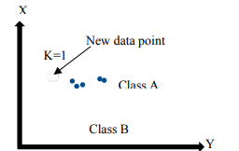
K- Nearest Neighbor
Its working rule is based on each data point which is labelled as neighbor.
This method consists of locating the nearest k data points in the training set towards the data point in which a target value is missing and allocating the average value of the obtained data points to it.

Slide 10


Confusion Matrix
 | Actual: NO | Actual: Yes
Predicted: No | True Negative | False Positive
Predicted: Yes | False Negative | True Positive
Accuracy
Error Rate

Slide 11
[1] A Stable AI-Based Binary and Multiple Class Heart Disease Prediction Model for IoMT IEEE TRANSACTIONS ON INDUSTRIAL INFORMATICS, VOL. 18, NO. 3, MARCH 2022 (Xiaoming Yuan , Jiahui Chen, Kuan Zhang , Yuan Wu and Tingting Yang)
Techniques/Algorithms/Approaches used:
Author have designed a Fuzzy-GBDT algorithmic rule combining Fuzzy Logic and Gradient Boosting Decision Tree (GBDT)
Achieved Result:
After combining Fuzzy Logic and Gradient Boosting Decision Tree (GBDT), it will decrease data complexity and increase the generalization of binary classification prediction.
Author have integrated Fuzzy-GBDT with Bagging to avoid overfitting
Issues:
GBDT is sensitive and could not process mass medical data efficiently
GBDT is weak classifier in the decision tree, which are trained in sequence

Slide 12
[2] An Integrated Machine Learning Framework for Effective Prediction of Cardiovascular Diseases IEEE Access VOLUME 9, 2021 (Aqsa Rahim, Yawar Rasheed, Farooque Azam, Muhammad Waseem Anwar, Muhammad Abdul Rahim, And Abdul Wahab Muzaffar)
Techniques/Algorithms/Approaches used:
An integrated machine learning framework Machine Learning based Cardiovascular Disease Diagnosis (MaLCaDD) is proposed where data balancing, feature selection and classification are targeted together for the improved and early prediction of heart diseases.
Improved prediction is achieved through the ensemble of Logistic Regression and KNN classifiers
Achieved Result:
Logistic Regression is used for predicting the specific dependent variable using a given set of independent variables
An accuracy of 99.1% has been achieved in prediction using this ensemble
Issues:
The efficiency or speed of algorithm declines as dataset grows

Slide 13
[3]HDPF: Heart Disease Prediction Framework Based on Hybrid Classifiers and Genetic Algorithm IEEE Access VOLUME 9, 2021 (Sarria E. A. Ashri , M. M. El-gayar , And Eman M. EL-Daydamony)
Techniques/Algorithms/Approaches used:
Logistical Regression (LR), Support Vector Machines (SVM), k-Nearest Neighbors (KNN), Decision Tree (DT), and Random Forest (RF)
10-folds cross-validation
Achieved Result:
The 10-folds cross-validation technique is used to beat the overfitting drawback
DT and RF achieved the highest precision and accuracy than the other algorithms. They were also the least time-consuming to implement the processing. The majority voting ensemble technique was used to the result with Random Forest to achieve high accuracy (98.18%).
Issues:
With 10-folds cross-validation, we need to train the model on multiple training sets.

Slide 14
[4] Machine Learning for Real-Time Heart Disease Prediction IEEE JOURNAL OF BIOMEDICAL AND HEALTH INFORMATICS, VOL. 25, NO. 9, SEPTEMBER 2021 (Dimitris Bertsimas , Luca Mingardi , Bartolomeo Stellato)
Techniques/Algorithms/Approaches used:
XGBoost algorithm, to train and evaluate models
The author present a novel procedure to accurately detect heart diseases in real-time from the analysis of short single-lead ECGs (9-61 seconds)
Achieved Result:
Proposed models prove to be a fast and reliable aid in the important task of detecting heart anomalies from the ECGs
Issues:
XGBoost does not perform well on sparse and unstructured data

Slide 15
[5] Recursion Enhanced Random Forest With an Improved Linear Model (RERF-ILM) for Heart Disease Detection on the Internet of Medical Things Platform IEEE Access VOLUME 8, 2020 (Chunyan Guo, Jiabing Zhang, Yang Liu, Yaying Xie, Zhiqiang Han, Jianshe Yu)
Techniques/Algorithms/Approaches used:
Recursion Enhanced Random Forest with associate degree improved linear model (RFRF-ILM)
The author introduced a fast-correlation-based selection technique (FCBF) to filter redundant functions
Support Vector Machine, K-Nearest Neighbor, Naïve Bayes, Random Forest
Achieved Result:
The SVM approach in disorder prediction has additional correct and fewer error.
In cardiopathy diagnosing, SVM plays better role with the highest accuracy
Issues:
Training complexity of SVM is very high, so it is not good for large datasets

Slide 16
[6] Heart Disease Prediction Using Supervised Machine Learning Algorithms 2021 5th International Conference on Information Systems and Computer Networks (ISCON) GLA University, Mathura, India. Oct 22-23, 2021 (Narendra Mohan, Vinod Jain, Gauranshi Agrawal)
Techniques/Algorithms/Approaches used:
Nave Bayes, Support Vector Machine, Decision Tree and K-Nearest Neighbour
Achieved Result:
Logistic Regression algorithm is best among four with 90.62% accuracy.
Issues:
if the number of observations is lesser than the number of features, Logistic Regression should not be used, otherwise, it may lead to overfitting.
16

Slide 17
[7] Heart Disease Prognosis Using Machine Learning Classification Techniques 2021 6th International Conference for Convergence in Technology (I2CT) Pune, India. Apr 02-04, 2021 (Mohammed Nowshad Ruhani Chowdhury, Ezaz Ahmed, Md. Abu Dayan Siddik)
Techniques/Algorithms/Approaches used:
Decision Tree, Logistic Regression, K-Nearest Neighbors (KNN), Naive Bayes, Support Vector Machine (SVM)
Instead of collecting data from any online resource, they collect it manually from six medical institutions
Achieved Result:
In this model Logistic Regression yielded maximum accuracy with 92.76% than all the other algorithms
Issues:
LR can overfit in high dimensional datasets
17

Slide 18
[8] Machine Learning-Based Heart Patient Scanning, Visualization and Monitoring 2021 International Conference on Computing Sciences (ICCS) (Ahmed Al Ahdal, Dr. Deepak Prashar, Manik Rakhra , Ankita Wadhawan)
Techniques/Algorithms/Approaches used:
KNN Decision Tree (DT), Logistic Regression, SVM, Random Forest (RF), and Naïve Bayes (NB)
Achieved Result:
Random Forest scored extremely well as it addresses the issue of overfitting by combining numerous algorithms.
The Nave Bayes classifier was highly quick and performed well in terms of computation
KNN gives highest accuracy of 87.5% among all other algorithms
Issues:
With a large number of datasets, the Decision Tree method performs poorly
18

Slide 19
[9] Machine Learning Based Heart Disease Prediction System 2021 International Conference on Computer Communication and Informatics (ICCCI 2021) (M.Snehith Raja, M.Anurag , Ch.Prachetan Reddy, NageswaraRao Sirisala)
Techniques/Algorithms/Approaches used:
Random Forest Algorithm
Achieved Result:
The accuracy of the result depends on the number of trees, a lot of the trees higher is the accuracy rate
Issues:
Random forests are found to be biased while dealing with categorical variables. It trains the information slowly. it's not appropriate for linear ways with a great deal of thin features.
19

Slide 20
[10] Prediction and Analysis of Heart Disease Using Machine Learning 2021 IEEE International Conference on Robotics, Automation and Artificial Intelligence (Yu Lin Khoury College of Computer Science, Northeastern University Boston, The United States)
Techniques/Algorithms/Approaches used:
Six machine learning algorithms Logistic Regression, K-nearest Neighbors, Adaboost, CART, Random Forest, XGBoost were applied
Achieved Result:
Random Forest was the best model that surpassed the remainder of the models with outstanding score of accuracy 84.80%.
Extreme Gradient Boosting (XGBoost) is an algorithm that implements gradient boosted decision trees for enhancing speed as well as performance.
Issues:
KNN may be a lazy learner because it doesn’t learn a model or perform from the training data however it “memorizes” the training dataset instead.

Slide 21
[11] A Comparison Based Study of Supervised Machine Learning Algorithms for Prediction of Heart Disease 1st International Conference on Computational Intelligence and Sustainable Engineering Solution(CISES2022) (Deepak Kumar Chohan, Dinesh C Dobhal)
Techniques/Algorithms/Approaches used:
Logistic Regression, Decision Tree, SVM, Naive Bayes, Random Forest, and KNN algorithm.
Dataset is used which was downloaded from Kaggle under the name of ‘Dataset for Heart Disease’. It contained 1025 samples along with 13 attributes (age, sex, cholesterol level, etc.)
Achieved Result:
The Random Forest algorithm gives 98.53% accurate results which is highest among all other algorithms used.
Issues:
Random forest trains the data slowly due to large number of samples.
Random forest algorithm may change considerable by a small change in the data.
21

Slide 22
[12] A Novel Approach for Prediction of Heart Disease using Machine Learning Algorithms 2021 Asian Conference on Innovation in Technology (ASIANCON) Pune, India. Aug 28-29, 2021 (Akanksha Kumari, Ashok Kumar Mehta)
Techniques/Algorithms/Approaches used:
Logistic Regression, Linear Discriminate Analysis, K Neighbors Classifier, Decision Tree Classifier, Gaussian Naïve Bayes, Support Vector Machine and Random Forest classifier
The used dataset is taken from Kaggle.
AdaBoost Ensemble Algorithm and Voting Ensemble Algorithm are used for improve accuracy rate of weak algorithms like Decision tree and Naïve Bayes.
Achieved Result:
After using AdaBoost and Voting method we got 100% accuracy of Logistic Regression, Decision Tree , SVC and RF.
Issues:
LR Does not support non-linear relationship between the predictor and the outcome

Slide 23
[13] Effective Study of Machine Learning Algorithms for Heart Disease Prediction 2022 2nd International Conference on Power Electronics & IoT Applications in Renewable Energy and Its Control (PARC) GLA University, Mathura, India. Jan 21-22, 2022 (Mihir J. Gaikwad, Prathmesh S. Asole, Prof. Leela S. Bitla)
Techniques/Algorithms/Approaches used:
Support Vector Machines, Gradient Boosting Classifier, Decision tree, Random forest, Logistic Regression
The heart-disease dataset is hosted on the UCI (University of California, Irvine) Machine Learning Repository, and it contains 270 patient records with 14 attributes.
Achieved Result:
The best algorithm for prediction is the Support Vector Machine, which has a pinpoint prediction accuracy of 82.35%.
Issues:
SVM doesn’t perform very well, when the data set has more noise i.e. target classes are overlapping.
23

Slide 24
[14] Feature Optimization Based Heart Disease Prediction using Machine Learning 2021 5th International Conference on Information Systems and Computer Networks (ISCON) GLA University, Mathura, India. Oct 22-23, 2021 (D.P.Yadav, Prabhav Saini, Pragya Mittal)
Techniques/Algorithms/Approaches used:
Support Vector Machine (SVM), K-Nearest Neighbor (KNN), Naïve Bayes and Random Forest algorithms
To increase accuracy rate of algorithms, genetic optimization technique is used
Achieved Result:
we got 96% accuracy with Naive Bayes algorithm which was 87% before applying the genetic optimization technique
Issues:
The algorithm which gave us the worst performance is SVM (81.31%)
Naïve Bayes learns fast and easily but if our training set is not ideal, NB can be highly biased and results will be garbage, there aren’t many parameters to fix things either.
24

Slide 25
[15] Heart Disease Detection using Machine Learning Technique Second International Conference on Electronics and Sustainable Communication Systems (ICESC-2021) IEEE Xplore Part Number: CFP21V66-ART; ISBN: 978-1-6654-2867-5 (Likitha KN, Nethravathi R, Nithyashree K, Ritika Kumari, Sridhar N, Venkateswaran K)
Techniques/Algorithms/Approaches used:
Logistic Regression, K Nearest Neighbor (K-NN), Decision Tree, Naive Bayes, Random Forest and Support Vector Machine
Achieved Result:
Random Forest algorithm gives the highest accuracy(96.6%) in this model
Issues:
Random Forest is that a large number of trees can make the algorithm too slow and ineffective for real-time predictions
25

Slide 26
[16] An Intelligent Learning System Based on Random Search Algorithm and Optimized Random Forest Model for Improved Heart Disease Detection IEEE Access VOLUME 7, 2019 (Ashir Javeed, Shijie Zhou, Liao Yongjian, Iqbal Qasim, Adeeb Noor, Redhwan Nour)
Techniques/Algorithms/Approaches used:
The planned diagnostic system uses random search algorithm (RSA) for features selection and random forest model for heart disease prediction
The planned diagnostic system is optimized using grid search algorithmic program.
Achieved Result:
The created models overfit to the testing data
The proposed methodology produces 3% higher accuracy than typical random forest model
Issues:
Random Search Algorithm (RSA) yields high during computing.

Slide 27
[17] Effective Heart Disease Prediction Using Hybrid Machine Learning Techniques IEEE Access VOLUME 7, 2019 (Senthilkumar Mohan, Chandrasegar Thirumalai, Gautam Srivastava)
Techniques/Algorithms/Approaches used:
Author proposed a prediction model for heart disease with the hybrid random forest with a linear model (HRFLM).
The proposed hybrid HRFLM method combines the features of Random Forest and Linear Method.
Author have used Neural networks as the tool for prediction of heart disease.
Author have used an R studio rattle to perform heart disease classification of the Cleveland UCI repository.
Achieved Result:
R studio provides an easy-to-use visual representation of the dataset, working environment and building the predictive analytics
HRFLM proved to be quite accurate in the prediction of heart disease.
Issues:
Author have used Neural networks are hard to interpret because they contain multiple layers of abstracted variables that connect hundreds or even thousands of neurons.

Slide 28
[18] HDPM: An Effective Heart Disease Prediction Model for a Clinical Decision Support System IEEE Access VOLUME 8, 2020 (Norma Latif Fitriyani, Muhammad Syafrudin, Ganjar Alfian, Jongtae Rhee )
Techniques/Algorithms/Approaches used:
Author have used the extreme gradient boosting (XGBoost) algorithm to detect the presence or absence of heart disease.
The outlier data from heart disease training datasets are eliminated by using the Density-Based Spatial Clustering of Applications with Noise (DBSCAN) method.
Synthetic Minority Over-sampling Technique-Edited Nearest Neighbor (SMOTE-ENN) is used to balance the training dataset
Achieved Result:
Author have utilized 10-fold cross-validation method to avoid the overfitting. Cross-validation allows the models to learn from different sets of training data by repeated sampling.
Issues:
With cross-validation, we need to train the model on multiple training sets which lead us to a high training time.

Slide 29

Approval Mail
29

Slide 30
References
[1] Xiaoming Yuan , Jiahui Chen, Kuan Zhang , Yuan Wu and Tingting Yang “A Stable AI-Based Binary and Multiple Class Heart Disease Prediction Model for IoMT” IEEE TRANSACTIONS ON INDUSTRIAL INFORMATICS, VOL. 18, NO. 3, MARCH 2022
[2] Aqsa Rahim, Yawar Rasheed, Farooque Azam, Muhammad Waseem Anwar, Muhammad Abdul Rahim, And Abdul Wahab Muzaffar “An Integrated Machine Learning Framework for Effective Prediction of Cardiovascular Diseases” IEEE Access VOLUME 9, 2021
[3] Sarria E. A. Ashri , M. M. El-gayar , And Eman M. EL-Daydamony “HDPF: Heart Disease Prediction Framework Based on Hybrid Classifiers and Genetic Algorithm” IEEE Access VOLUME 9, 2021
[14] Dimitris Bertsimas , Luca Mingardi , Bartolomeo Stellato “Machine Learning for Real-Time Heart Disease Prediction” IEEE JOURNAL OF BIOMEDICAL AND HEALTH INFORMATICS, VOL. 25, NO. 9, SEPTEMBER 2021
[5] Chunyan Guo, Jiabing Zhang, Yang Liu, Yaying Xie, Zhiqiang Han, Jianshe Yu “Recursion Enhanced Random Forest With an Improved Linear Model (RERF-ILM) for Heart Disease Detection on the Internet of Medical Things Platform” IEEE Access VOLUME 8, 2020
[6] Narendra Mohan, Vinod Jain, Gauranshi Agrawal, “Heart Disease Prediction Using Supervised Machine Learning Algorithms ” 2021 5th International Conference on Information Systems and Computer Networks (ISCON) GLA University, Mathura, India. Oct 22-23, 2021
[7] Mohammed Nowshad Ruhani Chowdhury, Ezaz Ahmed, Md. Abu Dayan Siddik, Akhlak Uz Zaman, “Heart Disease Prognosis Using Machine Learning Classification Techniques” 2021 6th International Conference for Convergence in Technology (I2CT) Pune, India. Apr 02-04, 2021
[8] Ahmed Al Ahda, Dr. Deepak Prashar, Manik Rakhra, Ankita Wadhawan, “Machine Learning-Based Heart Patient Scanning, Visualization, and Monitoring” 2021 International Conference on Computing Sciences (ICCS)
[9] M.Snehith Raja, M.Anurag , Ch.Prachetan Reddy, NageswaraRao Sirisala, “Machine Learning Based Heart Disease Prediction System” 2021 International Conference on Computer Communication and Informatics (ICCCI 2021), Jan 27-29
[10] Yu Lin Khoury College of Computer Science, Northeastern University Boston, The United States “Prediction and Analysis of Heart Disease Using Machine Learning” 2021 IEEE International Conference on Robotics, Automation and Artificial Intelligence
30

Slide 31
References
[11] Deepak kumar chohan and Dinesh C Dobhal, “A Comparison Based Study of Supervised Machine Learning Algorithms for Prediction of Heart Disease” 1st International Conference on Computational Intelligence and Sustainable Engineering Solution(CISES-2022)
[12] Akanksha Kumari, Ashok Kumar Mehta, “A Novel Approach for Prediction of Heart Disease using Machine Learning Algorithms ” 2021 Asian Conference on Innovation in Technology (ASIANCON) Pune, India. Aug 28-29, 2021
[13] Mihir J. Gaikwad, Prathmesh S. Asole, Prof. Leela S. Bitla, “Effective Study of Machine Learning Algorithms for Heart Disease Prediction ” 2022 2nd International Conference on Power Electronics & IoT Applications in Renewable Energy and Its Control (PARC) GLA University, Mathura, India. Jan 21-22, 2022
[14] D.P.Yadav, Prabhav Saini, Pragya Mittal, “Feature Optimization Based Heart Disease Prediction using Machine Learning” 2021 5th International Conference on Information Systems and Computer Networks (ISCON) GLA University, Mathura, India. Oct 22-23, 2021
[15] Likitha KN, Nethravathi R, Nithyashree K, Ritika Kumari, Sridhar N, Venkateswaran K, “Heart Disease Detection using Machine Learning Technique” Proceedings of the Second International Conference on Electronics and Sustainable Communication Systems (ICESC-2021) IEEE Xplore Part Number: CFP21V66-ART; ISBN: 978-1-6654-2867-5
[16] Ashir Javeed, Shijie Zhou, Liao Yongjian, Iqbal Qasim, Adeeb Noor, Redhwan Nour “An Intelligent Learning System Based on Random Search Algorithm and Optimized Random Forest Model for Improved Heart Disease Detection” IEEE Access VOLUME 7, 2019
[17] Senthilkumar Mohan, Chandrasegar Thirumalai, Gautam Srivastava “Effective Heart Disease Prediction Using Hybrid Machine Learning Techniques” IEEE Access VOLUME 7, 2019
[18] Norma Latif Fitriyani, Muhammad Syafrudin, Ganjar Alfian, Jongtae Rhee “HDPM: An Effective Heart Disease Prediction Model for a Clinical Decision Support System” IEEE Access VOLUME 8, 2020

Slide 32
Thank You
32

